Slide 1

EduBridge
“School Management
System ”
Group Members
BONDRE AMRUTA
in the guidance of
Ms. Amruta

Slide 2
INDEX
Introduction
JavaBeans
Screenshot
Advantage
References
conclusion

Slide 3
INTRODUCTION
A School management System consist of students and teachers.
The school management system is a web-based system which will use as a platform for interaction between student, teachers
The main objective of the School Management System is to manage the details of School, Students, Teachers.
It manages all the information related to fees and expenses.
The project is beneficial for school.
The software system allows the students total fees , paidFees , teacher salary , school revenue and school expenses.

Slide 4
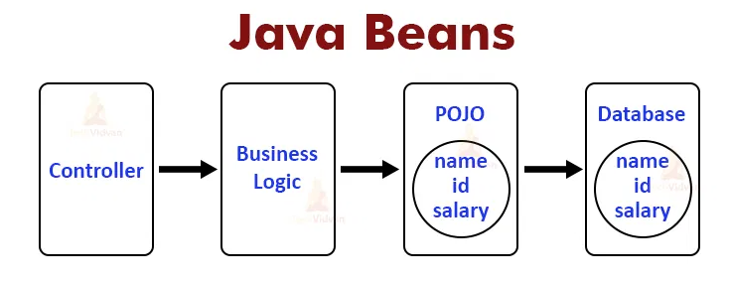
JAVA BEANS

Slide 5
What are JavaBean Properties?
A JavaBean property can be accessed by the user of the object. The feature can be of any Java data type, containing the classes that you define. It may be of the following mode: read, write, read-only, or write-only. JavaBean features are accessed through two method-
1. getStudentName ()
2.setStudentName ()

Slide 6
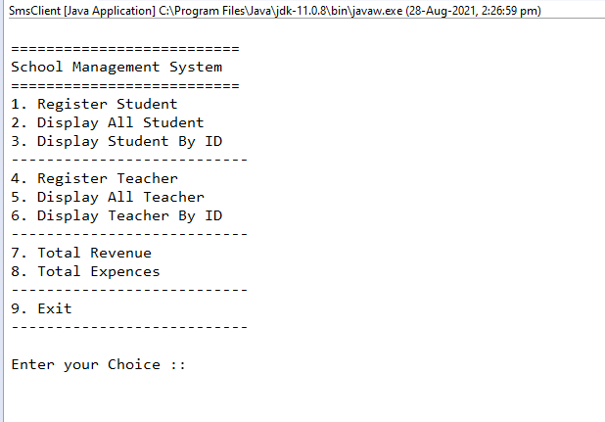
SCREENSHOT
Output

Slide 7
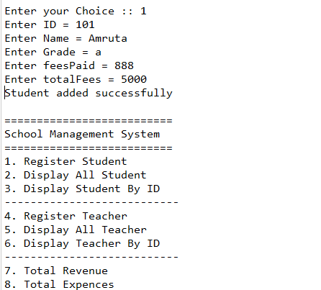
Add Student

Slide 8
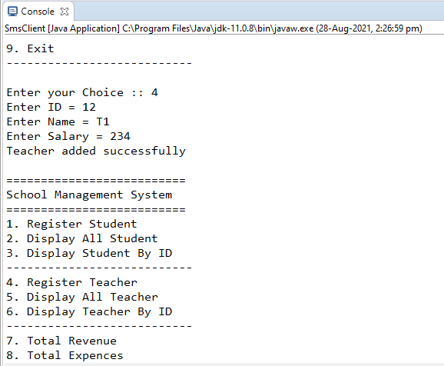
Add Student Successfully

Slide 9
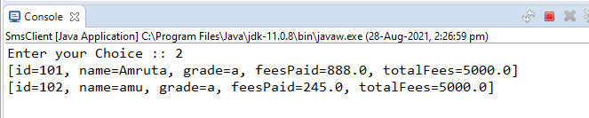
Display Student List

Slide 10
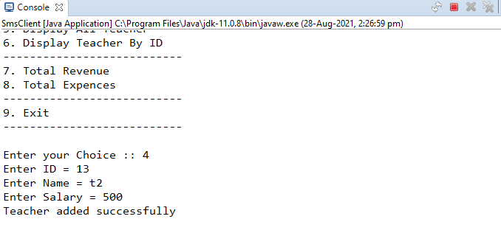
Add Teacher Successfully

Slide 11
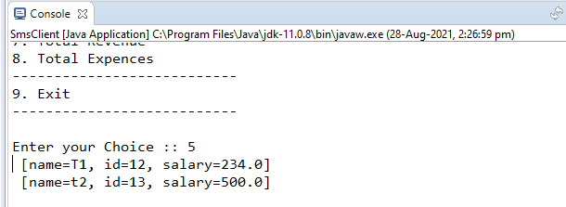
Display Teacher List

Slide 12
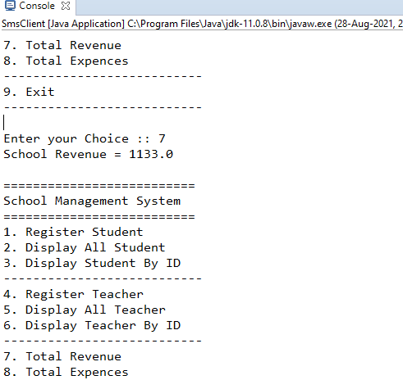
School Revenue

Slide 13
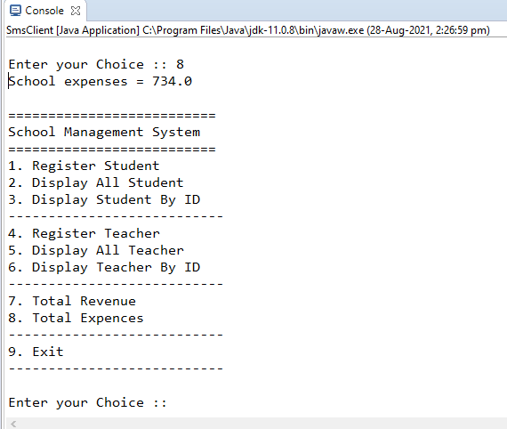
School Expenses

Slide 14
ADVANTAGES:-
Easily visible all detail.
This system saves time and efforts.
Manually Work done by this system.

Slide 15
REFERENCES
JAVA Technologies.
JAVA Compile Reference.
JAVA TUTORIAL.
JAVA T POINT.
WWW.EDUBRIDGEINDIA.COM

Slide 16
CONCLUSION
The project work titled “School Management System” has been designed using Java where in many friendly from controls have been added in order to make it a used interactive application. The system is developed in such a way that the user with common knowledge of computers can handle it easily. The system developed has proved to be user friendly and efficient in achieving basic goals.
The main idea was to develop an easy to display school related expanses and revenue . up to date all fees and salary related record are stored.

Slide 17

THANK YOU!!!

